Slide 1

Jobs and Salaries in the Data Field
By: Michael Zelaya

Slide 2
Project Overview:
Exploratory Data Analysis (EDA)
Methods/Modeling
Preliminary Results
Final Results
Conclusion/Future Work
Reflection

Slide 3
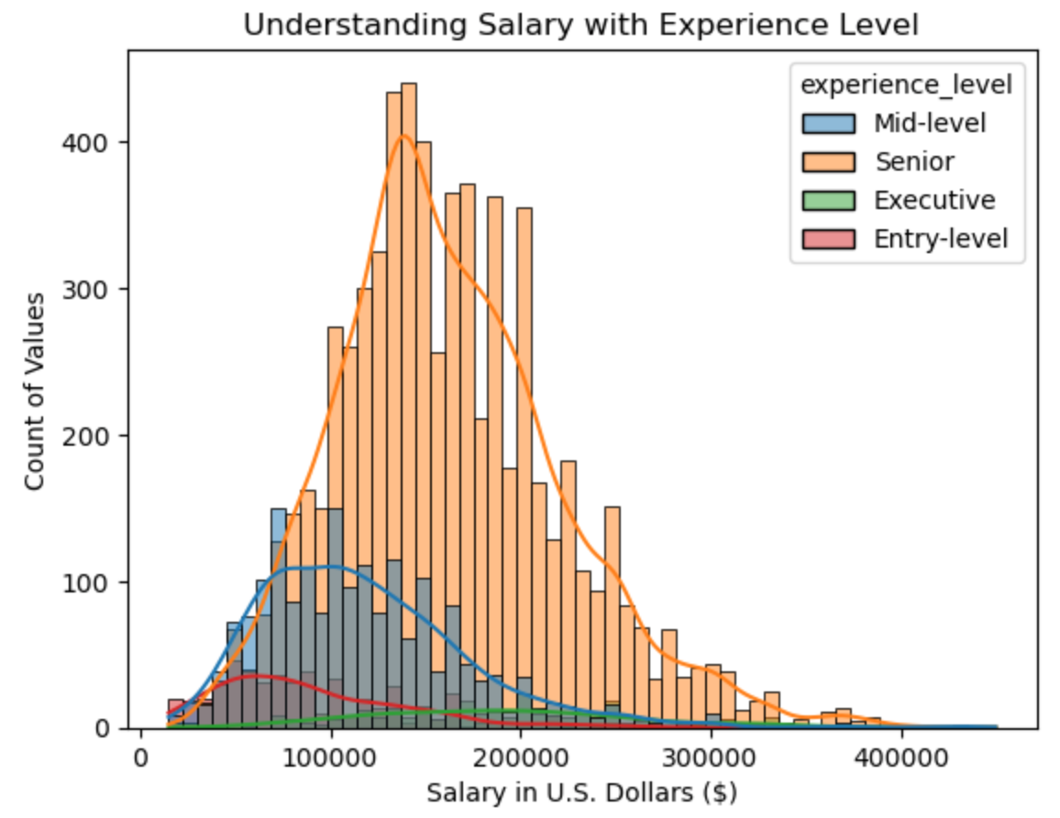
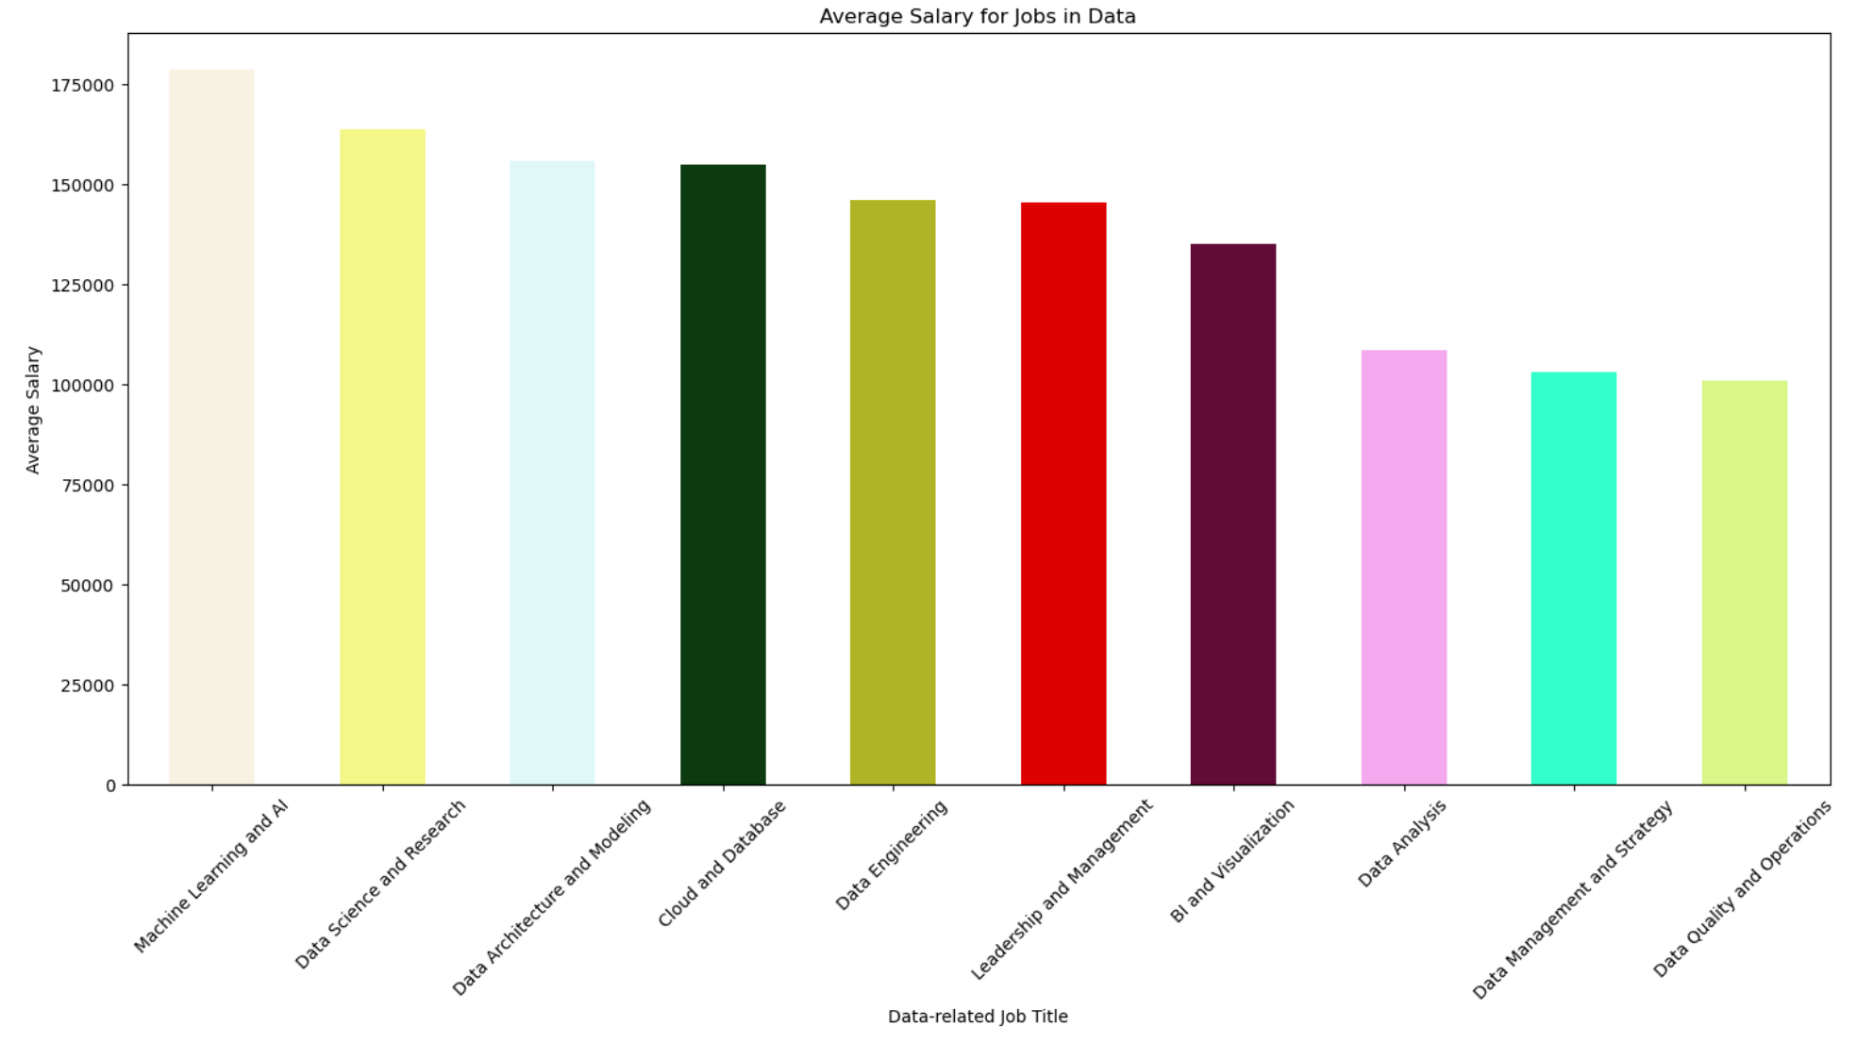
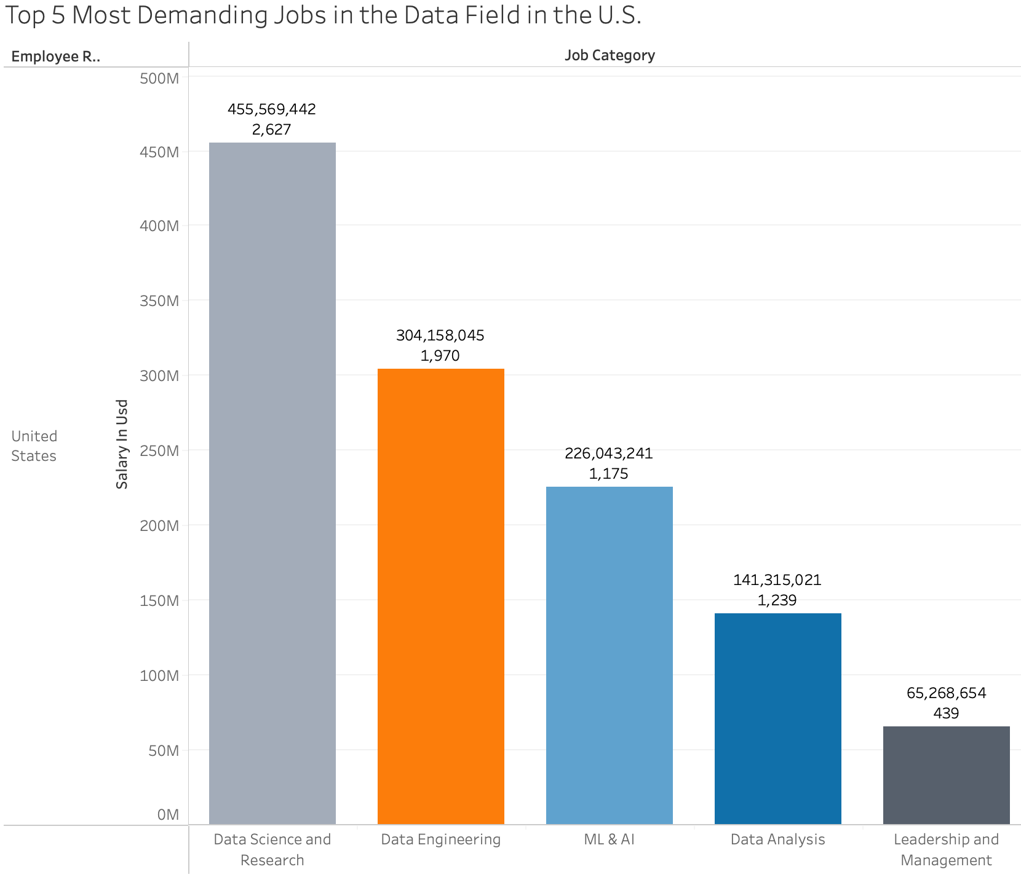
Exploratory Data Analysis (EDA):

Slide 4

Methods/Modeling:
K-Nearest Neighbor
(85,15) split
Random state = 1
K = from 0 to 50
Random Forest
100 trees
Random state = 1
Gradient Boosting
100 trees
Learning rate = 0.1
Max depth = 3
Random state = 1

Slide 5
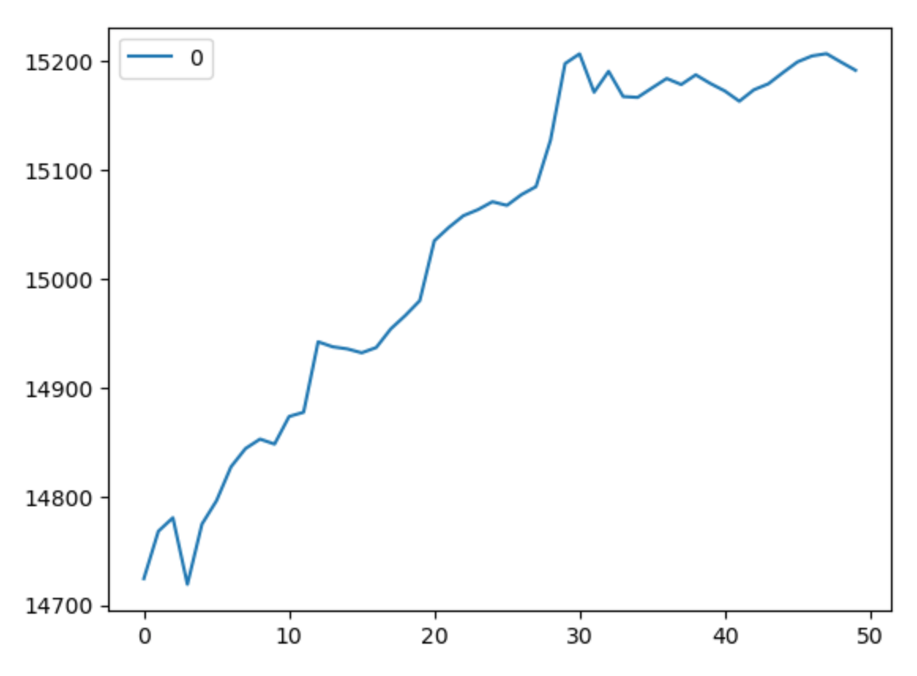
Preliminary Results:
K-Nearest Neighbor
At K = 4, it gave the best result, as the lower the RMSE score, the better.
Accuracy of the model:
94.69%
The KNN’s model accuracy was around 94.69%, using a test size of 15% and a random state of 1.

Slide 6
Final Results:
Random Forest Regressor:
Accuracy of the model:
95.27%
Gradient Boosting Regressor
Accuracy of the model:
97.95%
The Gradient Boosting Regressor model accuracy score is around 97.95% when using 100 trees, a learning rate of 0.1, a max depth of 3, and a random state of 1.
The Random Forest Regressor model had an accuracy score of around 95.27% when using 100 trees and a random state of 1.
It also had the best accuracy score out of the three ML models.

Slide 7

Conclusion/Future Work:
Conclusion:
Long-semester project focused on analyzing and using various ML models like K-nearest neighbor, Random Forest, and Gradient Boosting to predict jobs salaries within the data field.
Although the accuracy improved drastically, it could still have room for improvement.
Future Work:
I hope to implement the updated dataset in the future.

Slide 8

Reflection:
Overall, this project was somewhat frustrating but a great learning experience.
Clean data, but the prediction or ML algorithms phase was something I struggled with.
Keep things simple; don’t try to do too much at once.

Slide 9

Summary:
I developed several predictive analytics models, including K-Nearest Neighbor, Random Forest, and Gradient Boosting, to predict job salaries within the data field.
Although the accuracy score was not initially what I had hoped for, it improved significantly after making no adjustments to the original dataset.
Accuracy Scores:
KNN: 94.69%
Random Forest: 95.27%
Gradient Boosting: 97.95%

Slide 10
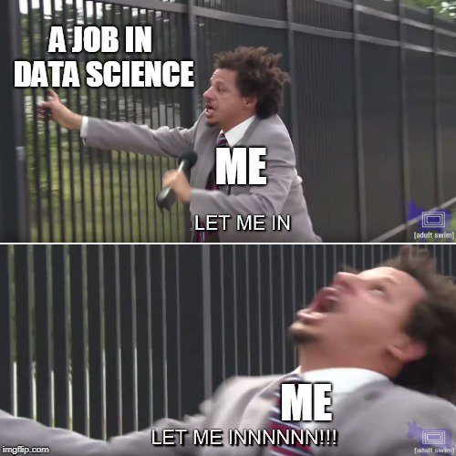

Questions:

